Slide 1

Frequency Shift Keying (FSK)
Duncan Wood
ENCE 4110
11/12/2025

Slide 2
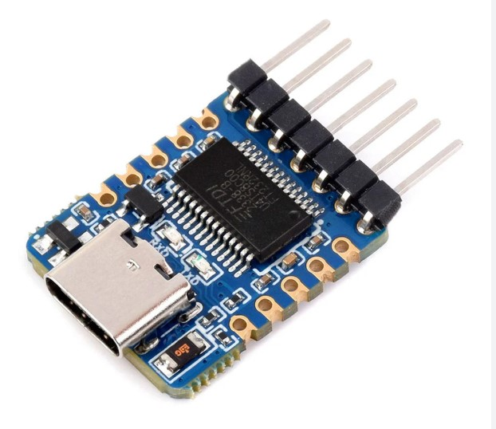

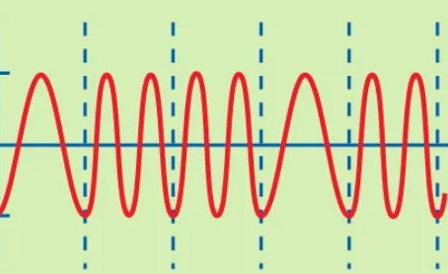
Introduction
Problem: Convert UART data into modulated FSK signal and send it back to the PC demodulated
MODULATOR
DEMODULATOR

Slide 3
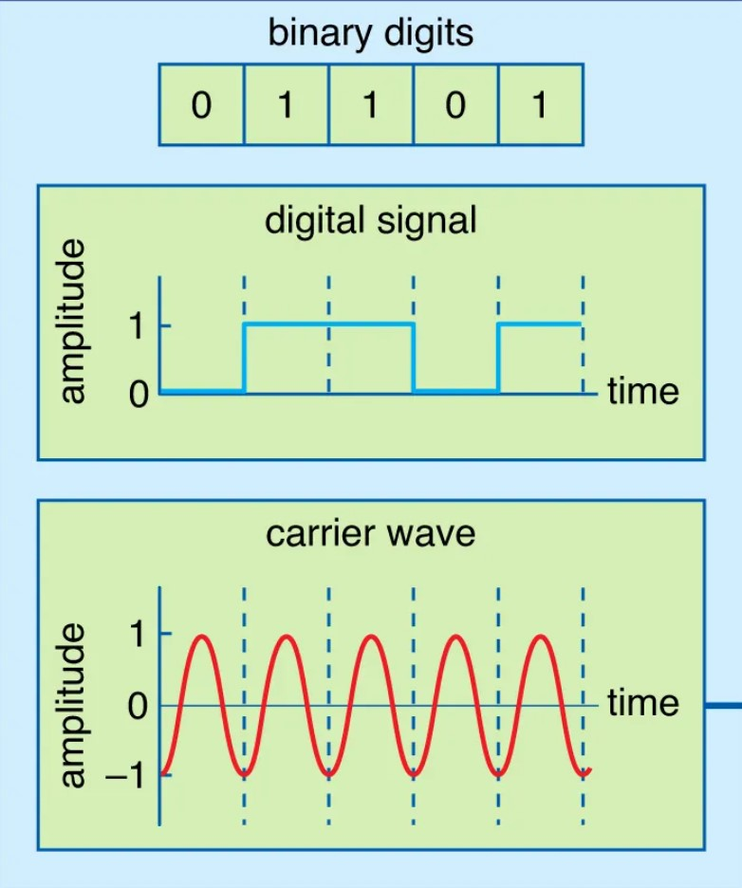
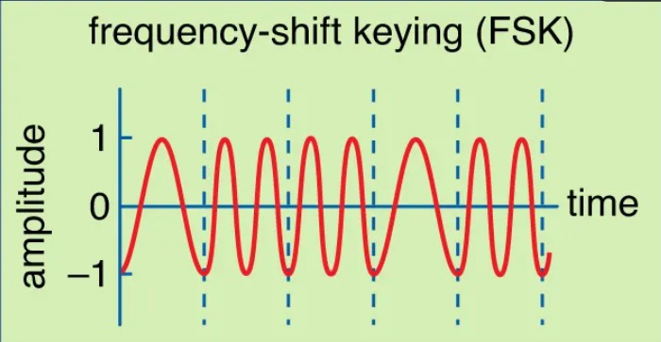
What is Frequency Shift Keying?
FSK is a digital modulation technique widely used in modern technology.
Bluetooth, digital radios, remotes.
The digital counterpart of Frequency Modulation (FM)

Slide 4
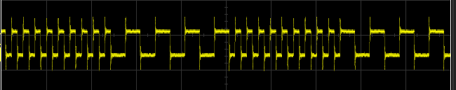
In this system...

Slide 5
System Overview
PC
SERIAL
UART
RX
FSK
TX
FSK MOD
FSK
DEMOD
UART
TX
PC
SERIAL
ASCII CHAR
BYTE
7-SEG
SCOPE
HEX[0]
GPIO[0]

Slide 6
FSK Transmit FSM
LOAD
Serializes byte into 10-bit frame (start, data, stop)
Holds each bit for defined number of clock cycles; the symbol period.
Synchronizes the UART data with the FSK modulator.
Data ready
recorded
IDLE
SEND
Sent to modulator

Slide 7
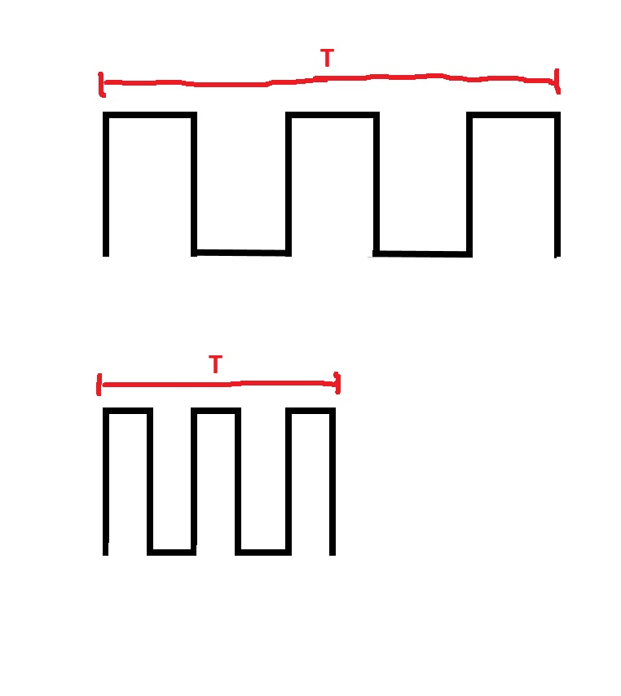
Symbol Timing
UART Baud: 115200
FPGA Clock: 50 MHz
Clocks per symbol = 50e6 / 115200 ≈ 434
One bit = 434 clock cycles → one full tone interval

Slide 8
FSK Modulator
FSM
Single bit
Toggle
Select
N0/N1
Simple toggle-counter structure:
Counter resets when reaching N₀/N₁
Output bit flips on reset → square wave
Frequency
f=1/(2xN)
If bit==1 use N1 (shorter interval → higher frequency).
If bit==0 use N0 (longer interval → lower frequency).
Toggle FSK Signal
counter
counter++ / clk

Slide 9
FSK Demodulator
MOD
FSK Signal
Edge-counting demodulator:
Detect transitions of fsk_in
Count edges per symbol window (434 clocks)
Compare to threshold (~20 edges)
Decision rule:
More edges → high tone → bit = 1
Fewer edges → low tone → bit = 0
Reassemble bits into bytes
Increments edge counter
Edge detector
Cycles clk until symbol period reached
Symbol timer
Sample
Recovered byte

Slide 10
UART Transmitter / Receiver
FSK
PC
SERIAL
UART
TX
UART
RX
PC
SERIAL
Receive and transmit the input and output message of the FSK logic.

Slide 11
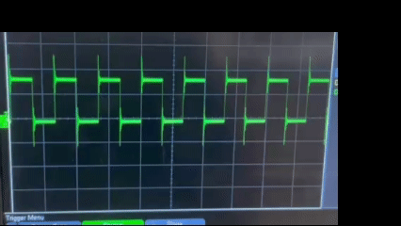
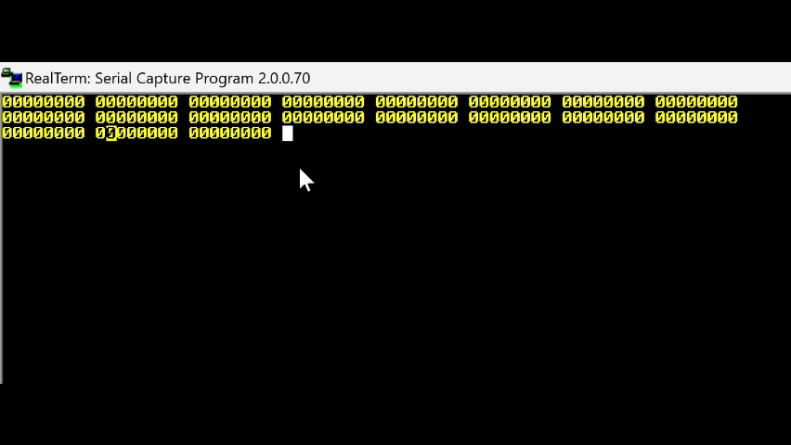
Testing and Verification

Slide 12
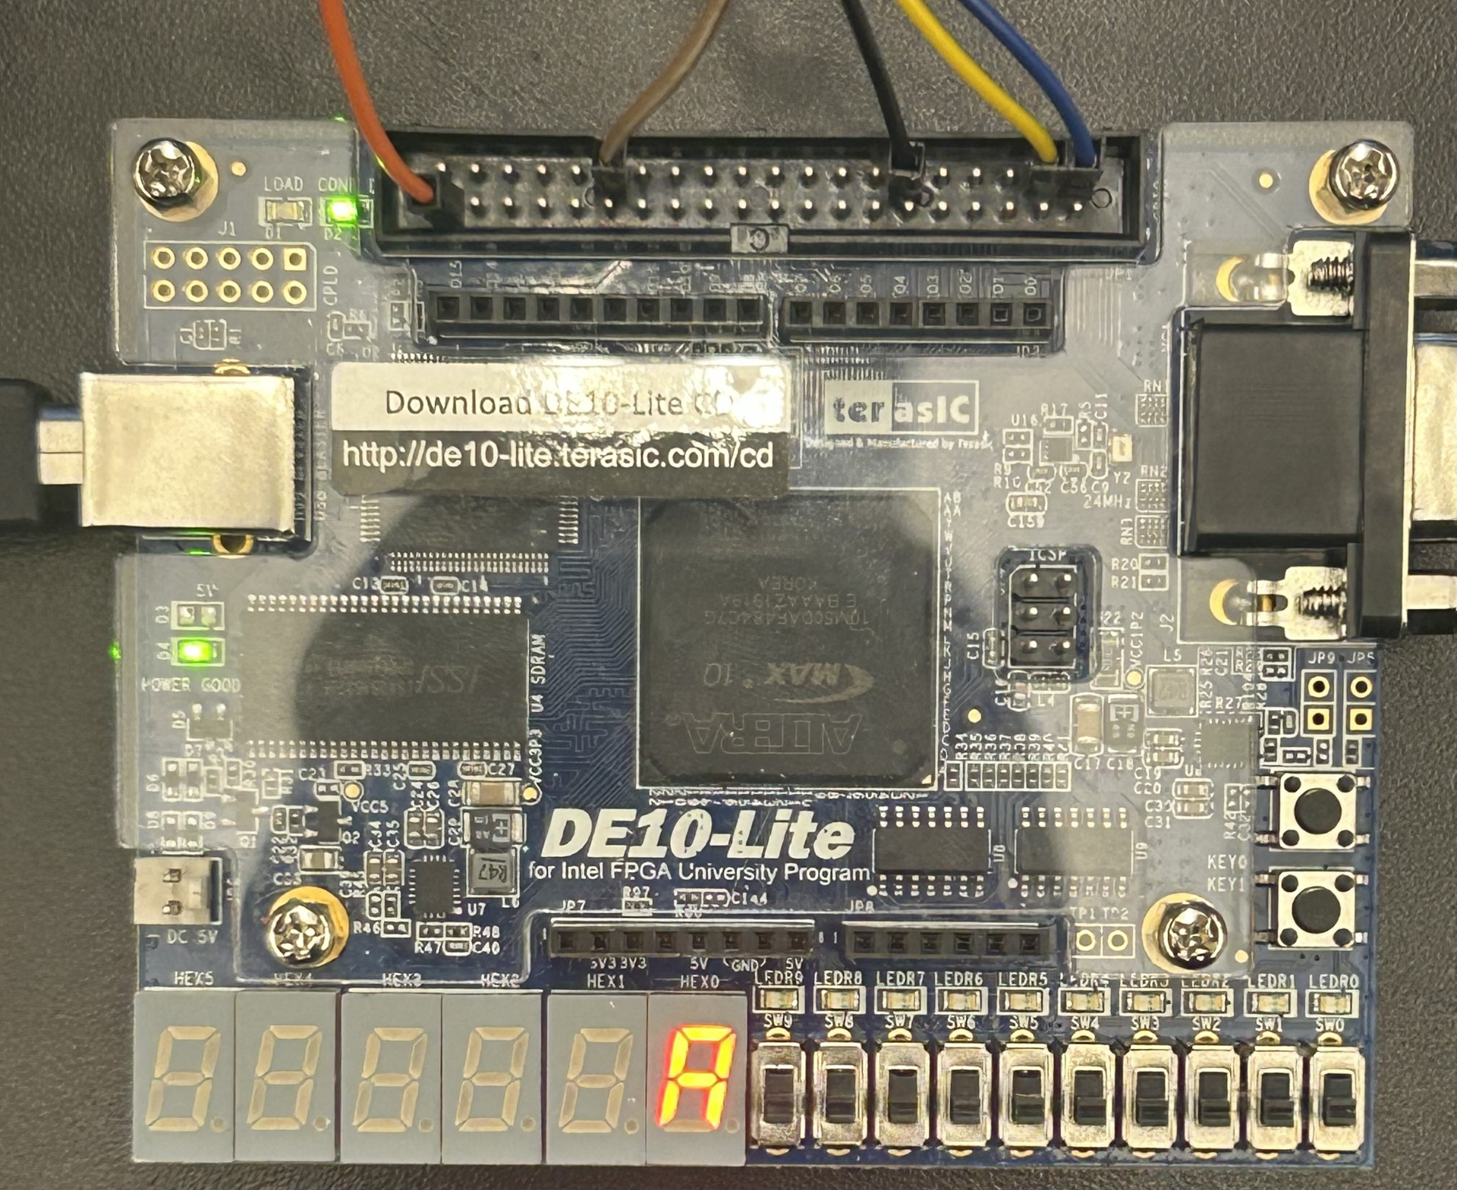

Slide 13
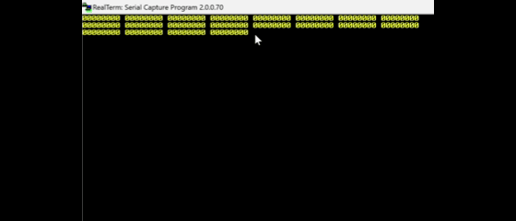

Slide 14
Future Work
Problem Observed
Characters echoed from the demodulator do not match the UART key pressed
Indicates bit or symbol misalignment between transmitter and receiver timing.
Likely causes
Symbol boundary drift — demodulator’s 434-clock window may start mid-symbol
Threshold sensitivity — fixed midpoint (≈ 20 edges) may mis-classify noisy or marginal tones.
Byte framing ambiguity — demodulator doesn’t yet detect start/stop bits; it simply groups 8 bits sequentially.
Possible Solution: add protocol layer and additional synchronizer to implement start/stop validation.

Slide 15

Conclusions
Built a complete digital FSK modem on FPGA.
.Demonstrated real-time chain:
UART RX → FSK TX FSM → Modulator → Demodulator → UART TX
Key Insights
Timing precision is key for symbol alignment
Simple edge count demodulation works conceptually but lacks robustness.

